Slide 1
Core scheduling: for SMT security and performance
Aubrey Li @ CLK2019
Intel Open Source Technology Center

Slide 2
Agenda
SMT Security
SMT Performance
Core scheduling
Future work

Slide 3

A roast on Linux Plumber Conference 2019

Slide 4



Security Issue: Side-channel Attack Example
L1 Terminal Fault(L1TF) Vulnerability
Exploit speculative execution to ignore the non-present page table entry (PTE) and load the referenced data if it is present in the Level 1 data cache
Mitigation
Host
PTE Inversion
Interrupt affinity
SMT off
Guest
L1D cache flush on privilege boundaries (VMENTER)
Guest VCPU confinement to dedicated physical cores
Disable extended page table (EPT)
Task isolation
CPU Core
SMT0
SMT1
cache

Slide 5
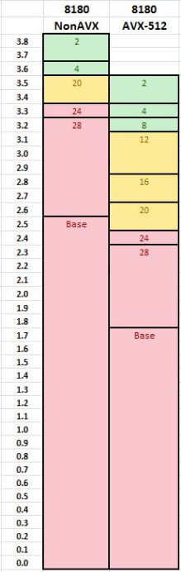
Performance Issue: Fast Instructions Go Slow
AVX512 instructions accelerate performance of demanding computational tasks up to 40% (vs AVX2)
Linpack, FPU Julia, etc
AVX512 pulls down the core max frequency
Good Case
Bad Case
Core0
Core1
NonAVX
NonAVX
AVX
AVX
Freq = 3.8GHz
Freq = 3.5GHz
Core0
Core1
NonAVX
AVX
NonAVX
AVX
Freq = 3.5GHz
Freq = 3.5GHz
5

Slide 6
Mitigate Frequency Reduction
AVX512 task detection
Performance monitoring event
core_power.lvl2_turbo_license
sysfs interface
cat /proc/<pid>/arch_status
AVX512_elapsed_ms: 12
cgroup interface for orchestration (TBD)
cat /sys/fs/cgroup/cpuacct/cpuacct.arch_status
AVX512_elapsed_ms: 12
AVX512 task isolation
6

Slide 7
CPU Scheduling
Core Scheduling
Per thread scheduling
Each thread selects task from its own runqueue
Load balance keeps runqueue balanced
Per core scheduling
All SMTs in a core select tasks together
scheduling for a core is synchronized
Core0
Core1
Core2
Core0
Core1
Core2
7

Slide 8
Core Scheduling Design
Make SMT usable on systems with L1TF
Have a core wide knowledge to schedule tasks on SMT instances
Core Cookie
Per-core run queue (and lock)
Force a sibling idle if no matched task found in the same core
resched IPI ensures no overlap
Core0
Core1
SMT0
SMT1
SMT2
SMT3
Idle
Core0
Core1
SMT0
SMT1
SMT2
SMT3
Non-AVX
Idle
AVX
AVX
AVX
8

Slide 9
Current Linux Scheduler Overview
CPU0
rq->cfs_rq->
task_timeline.rb_tree
sched_entity
virtual runtime
sleep
wakeup
wait queue
load balance
wakeup
sleep
CPU1
rq->cfs_rq->
task_timeline.rb_tree
virtual runtime
9

Slide 10
Upstream Proposal – Core Scheduling
CPU0
rq->cfs_rq->
task_timeline.rb_tree
core_cookie
core_tree.rb_tree
sched_entity
virtual runtime
sleep
wakeup
wait queue
load balance
task priority
wakeup
sleep
CPU1
rq->cfs_rq->
task_timeline.rb_tree
core_cookie
core_tree.rb_tree
virtual runtime
10

Slide 11
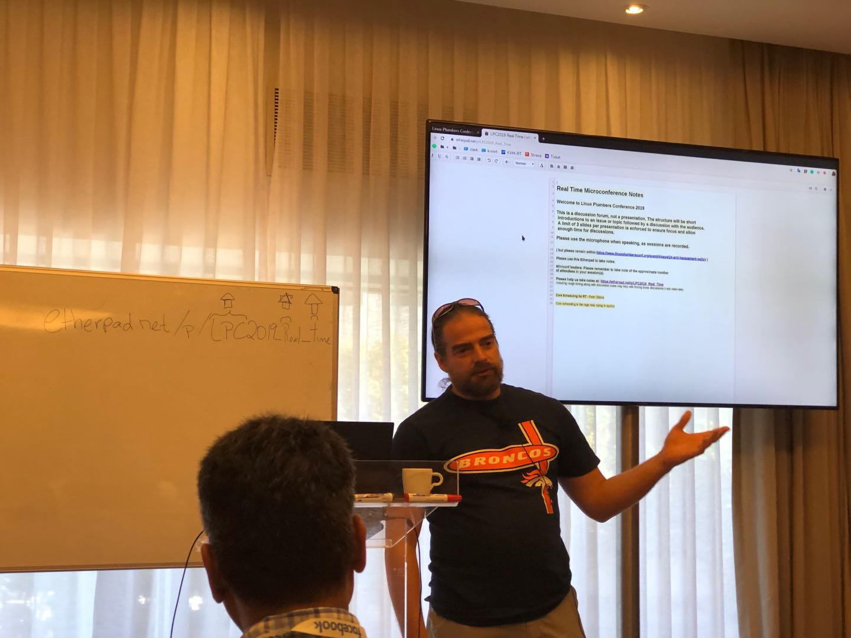
Core Scheduling Current Status
V3 posted
Initiated by Peter Zijlstra(V1)
Build and stability fixes(V2)
Bug fixes and Performance optimization(V3)
It will eventually be merged, for:
Security(L1TF, MDS)
Performance(Workload colocation)
Real time
etc
11

Slide 12
Performance Result
sysbench CPU + Gemmbench
Core scheduling shows 10%~20% improvement against default case
12

Slide 13
Performance Result
sysbench mysql + Gemmbench
Core scheduling shows 60% improvement at mid load case but -80% regression at overload case
13

Slide 14
Future Work - Security
User to Kernel Attack Isolation
Interrupt
Syscall
VMEXIT
VM0
VM1
App
…
App
App
…
App
Guest OS0
Guest OS1
VM exit
VM Monitor
SMT0
SMT1
L1 Cache
14

Slide 15
Future Work - Performance
Fairness
Task placement
Performance regression
15

